Slide 1




Discovering Hierarchy of Bipartite Graphs with Cohesive Subgraphs
Kai Wang, Wenjie Zhang, Xuemin Lin,
Ying Zhang and Shunyang Li

Slide 2
Outline
Introduction
Problem definition
Challenges and solutions
Experiments
Conclusion

Slide 3
Introduction
A bipartite graph
u0
u1
u2
u3
u4
u5
u6
u7
v0
v1
v2
v3
v4
v5
v6

Slide 4
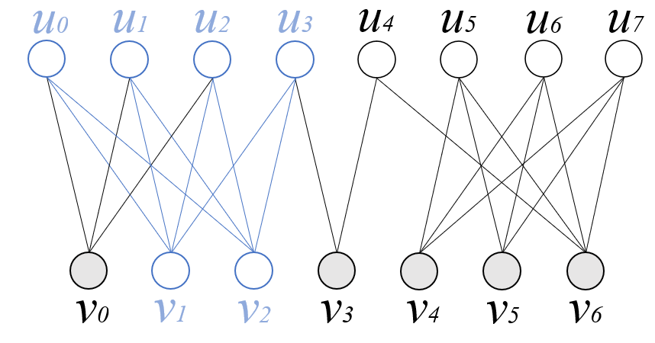
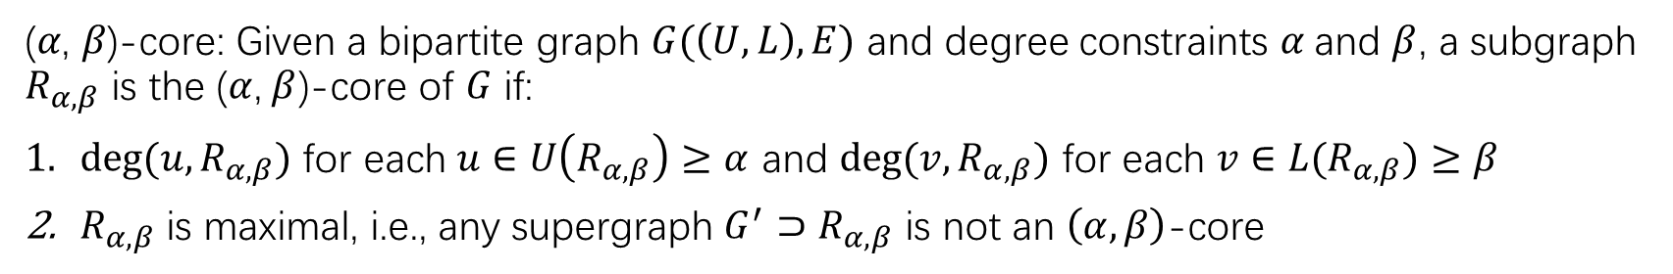
Introduction
(𝛼, 𝛽)-core: Given a bipartite graph $G(\left(U,L\right),E)$ and degree constraints $α$and $β$, a subgraph $R_{α,β}$ is the ($α$,$β$)-core of $G$ if:
$deg(u,R_{α,β})$ for each $u∈U\left(R_{α,β}\right)≥α$ and $deg(v,R_{α,β})$ for each $v∈L(R_{α,β})≥β$
$R_{α,β}$ is maximal, i.e., any supergraph $G^{′}⊃R_{α,β}$ is not an $\left(α,β\right)$-core
(2, 4)-core

Slide 5
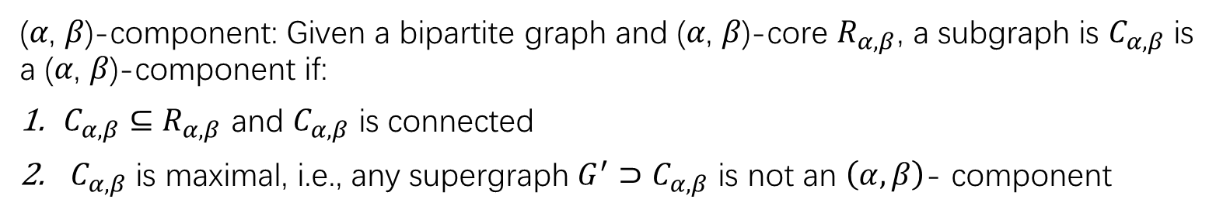
Introduction
(𝛼, 𝛽)-component: Given a bipartite graph and (𝛼, 𝛽)-core $R_{α,β}$, a subgraph is $C_{α,β}$ is a (𝛼, 𝛽)-component if:
$C_{α,β}⊆$ $R_{α,β}$ and $C_{α,β}$ is connected
${ C}_{α,β}$ is maximal, i.e., any supergraph $G^{′}⊃C_{α,β}$ is not an $\left(α,β\right)$- component
(2, 4)- component

Slide 6
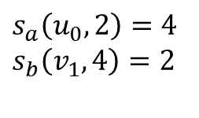
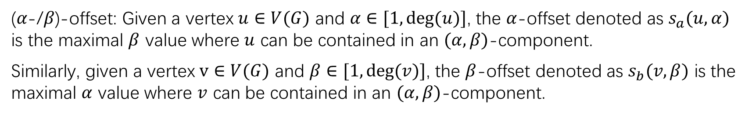
Introduction
(𝛼-/𝛽)-offset: Given a vertex $u∈V(G)$ and $α∈[1, deg(u)]$, the $α$-offset denoted as $s_{a}(u, α)$ is the maximal $β$ value where $u$ can be contained in an $(α, β)$-component.
Similarly, given a vertex $v∈V(G)$ and $β∈[1, deg(v)]$, the $β$-offset denoted as $s_{b}(v, β)$ is the maximal $α$ value where $v$ can be contained in an $(α, β)$-component.
$s_{a}\left(u_{0}, 2\right)=4$
$s_{b}\left(v_{1}, 4\right)=2$

Slide 7
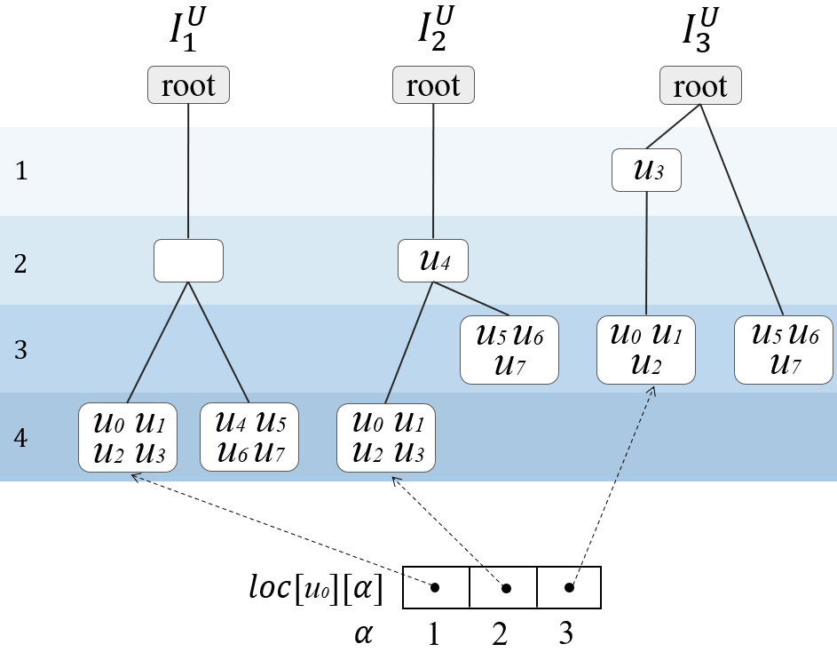
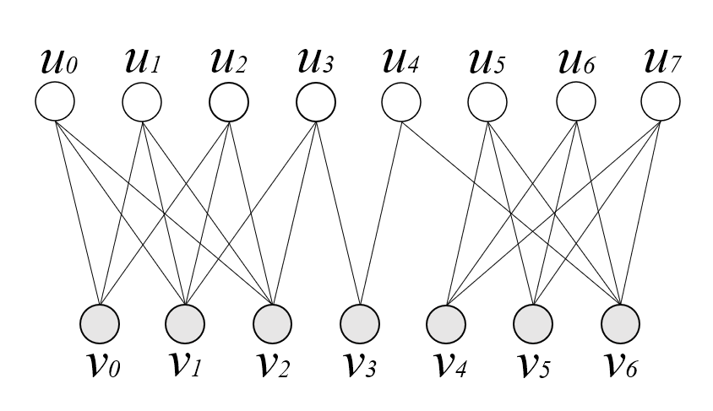
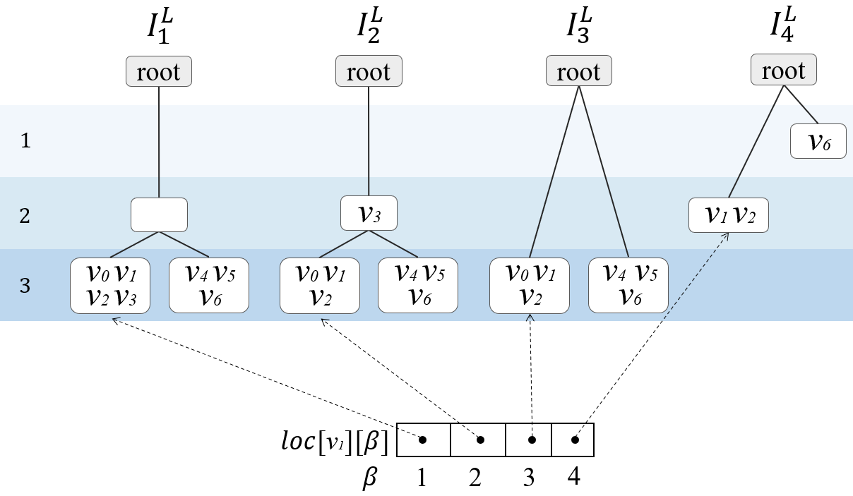

Problem definition
Given a bipartite graph G, we aim to build the bipartite hierarchy that consists of the upper hierarchy for upper vertices and the lower hierarchy for lower vertices according to the $\left(α, β\right)$-cores and the connectivity.
the upper hierarchy
the lower hierarchy

Slide 8
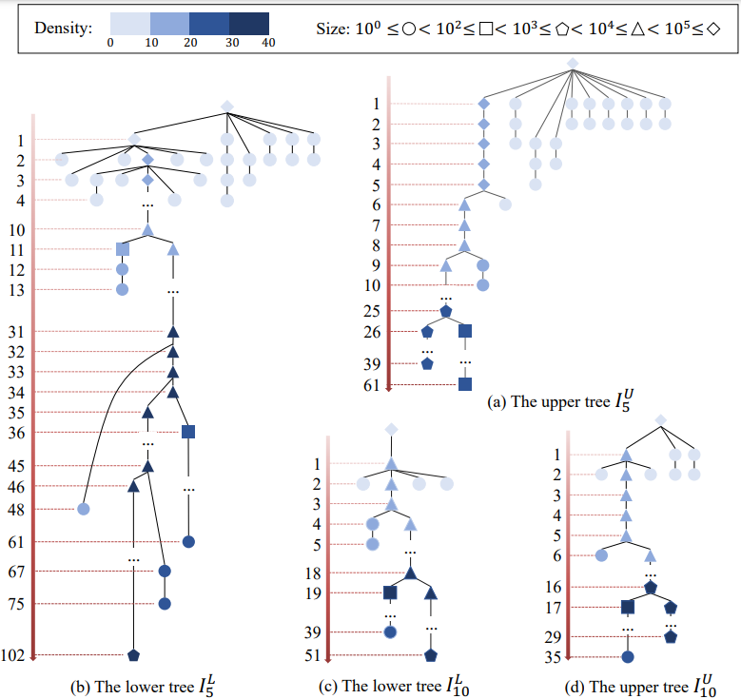
Applications
Bipartite network visualization
Reveal the relationships of vertices
  Community density
  Dense regions
Generate insights for network analysis
  For IMDB dataset, we can analyze the involvement of people (or the importance of actors) at different levels of granularity

Slide 9
Applications
Efficient community search
  Searching communities can support many real-world applications (e.g., recommendation)
Evaluating vertex engagement
  Evaluate the vertex engagement in bipartite graphs based on the positions of vertices in the hierarchy

Slide 10

Related works
General (unipartite) graphs
  Cohesive subgraph models: k-core [1-2], k-truss [3-4], k-ECC [5-6], …
Bipartite graphs
  K-bitruss [7-8], $\left(α, β\right)$-core [9-11], $\left(α, β\right)$-community [12] …

Slide 11
Challenges
How to efficiently build the bipartite hierarchy.
How to efficiently maintain the bipartite hierarchy.
How to efficiently obtain the communities from the bipartite hierarchy.

Slide 12
Bipartite hierarchy construction
We design two approaches to build bipartite hierarchy:
Top-down approach
Bottom-up approach

Slide 13
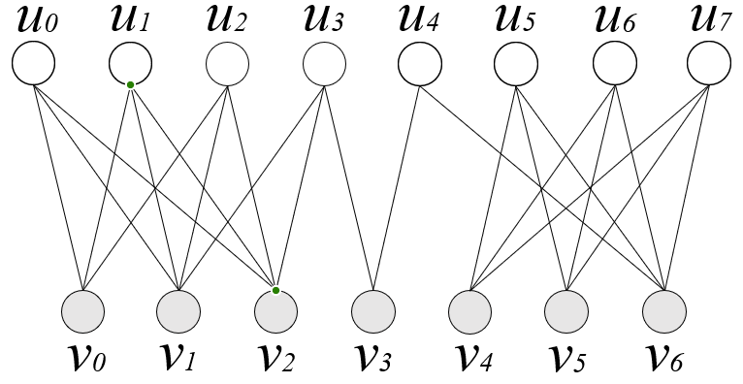
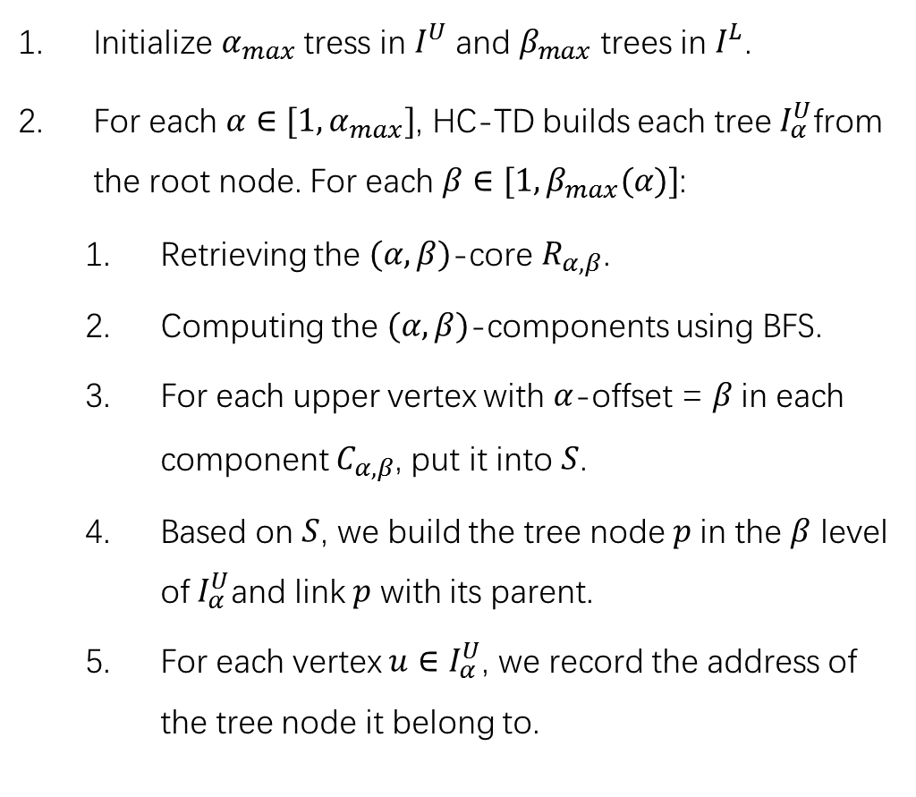
Top-down approach
Initialize $α_{max}$ tress in $I^{U}$and $β_{max}$ trees in $I^{L}$.
For each $α∈[1, α_{max}]$, HC-TD builds each tree $I_{α}^{U}$from the root node. For each $β∈[1, β_{max}(α)]$:
  Retrieving the $(α, β)$-core $R_{α, β}$.
  Computing the $(α,β)$-components using BFS.
  For each upper vertex with $α$-offset = $β$in each component $C_{α, β}$, put it into $S$.
  Based on $S$, we build the tree node $p$in the $β$ level of$I_{α}^{U}$and link $p$ with its parent.
  For each vertex ${u∈I}_{α}^{U}$, we record the address of the tree node it belong to.

Slide 14



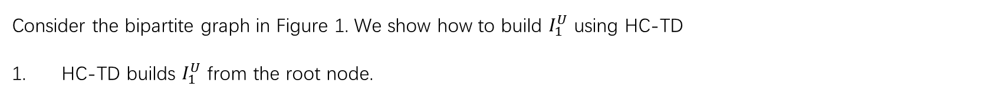


Top-down approach (example)
Consider the bipartite graph in Figure 1. We show how to build $I_{1}^{U}$ using HC-TD
HC-TD builds $I_{1}^{U}$ from the root node.
$$I_{1}^{U}$$
u0
u1
u2
u3
u4
u5
u6
u7
root
$$1$$
$$2$$
$$3$$
v0
v1
v2
v3
v4
v5
v6
$$4$$
Fig. 1. A bipartite graph G

Slide 15
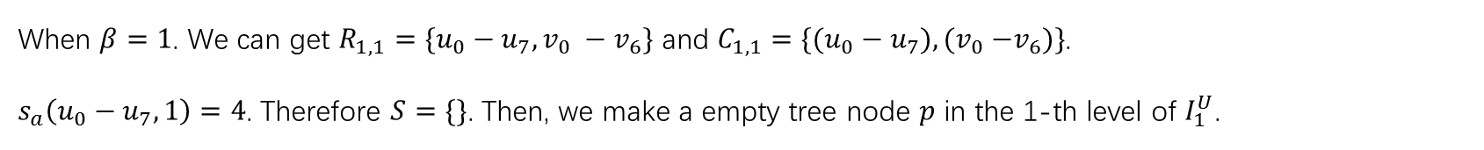
Top-down approach (example)
When $β=1$. We can get $R_{1, 1}=\{u_{0}−u_{7}, v_{0} −v_{6}\}$ and $C_{1, 1}=\{(u_{0}−u_{7}), {(v}_{0} −v_{6})\}$.
$s_{a}\left(u_{0}−u_{7}, 1\right)=4$. Therefore $S=\{\}$. Then, we make a empty tree node $p$ in the 1-th level of $I_{1}^{U}$.
$$I_{1}^{U}$$
u0
u1
u2
u3
u4
u5
u6
u7
root
$$1$$
（1-1)-core
$$2$$
$$3$$
v0
v1
v2
v3
v4
v5
v6
$$4$$
Fig. 1. A bipartite graph G

Slide 16
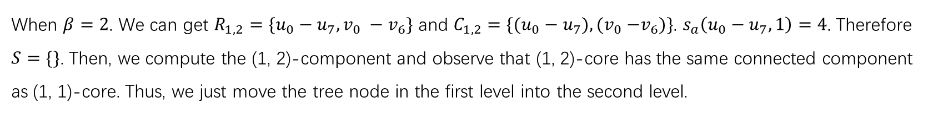
Top-down approach (example)
When $β=2$. We can get $R_{1, 2}=\{u_{0}−u_{7}, v_{0} −v_{6}\}$ and $C_{1, 2}=\{(u_{0}−u_{7}), {(v}_{0} −v_{6})\}$. $s_{a}\left(u_{0}−u_{7}, 1\right)=4$. Therefore $S=\{\}$. Then, we compute the (1, 2)-component and observe that (1, 2)-core has the same connected component as (1, 1)-core. Thus, we just move the tree node in the first level into the second level.
$$I_{1}^{U}$$
u0
u1
u2
u3
u4
u5
u6
u7
root
$$1$$
（1-2)-core
$$2$$
$$3$$
v0
v1
v2
v3
v4
v5
v6
$$4$$
Fig. 1. A bipartite graph G

Slide 17
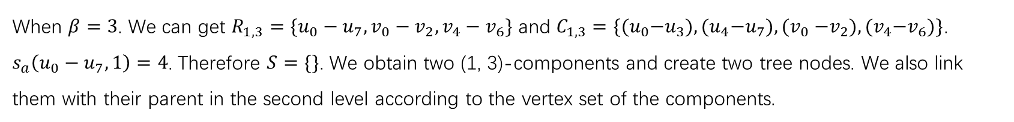
Top-down approach (example)
When $β=3$. We can get $R_{1, 3}=\{u_{0}−u_{7},v_{0}−v_{2},v_{4}−v_{6}\}$ and $C_{1, 3}=\{{(u}_{0}−u_{3}), {(u}_{4}−u_{7}), {(v}_{0} −v_{2}),{(v}_{4}−v_{6})\}$. $s_{a}\left(u_{0}−u_{7}, 1\right)=4$. Therefore $S=\{\}$. We obtain two (1, 3)-components and create two tree nodes. We also link them with their parent in the second level according to the vertex set of the components.
$$I_{1}^{U}$$
u0
u1
u2
u3
u4
u5
u6
u7
root
$$1$$
（1-3)-core
$$2$$
$$3$$
v0
v1
v2
v3
v4
v5
v6
$$4$$
Fig. 1. A bipartite graph G

Slide 18




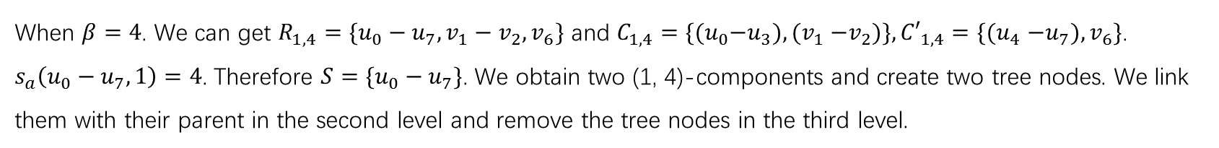



Top-down approach (example)
When $β=4$. We can get $R_{1, 4}=\{u_{0}−u_{7},v_{1}−v_{2},v_{6}\}$ and $C_{1, 4}=\{{(u}_{0}−u_{3}), {(v}_{1} −v_{2})\},{{C′}_{1, 4}{=\{(u}_{4}−u_{7}),v}_{6}\}$. $s_{a}\left(u_{0}−u_{7}, 1\right)=4$. Therefore $S=\{u_{0}−u_{7}\}$. We obtain two (1, 4)-components and create two tree nodes. We link them with their parent in the second level and remove the tree nodes in the third level.
$$I_{1}^{U}$$
u0
u1
u2
u3
u4
u5
u6
u7
root
$$1$$
（1-4)-core
$$2$$
$$3$$
v0
v1
v2
v3
v4
v5
v6
$$4$$
u0 u1 u2 u3
u4 u5 u6 u7
Fig. 1. A bipartite graph G
$loc[$u$][α]$
$$α$$
1
..
..

Slide 19
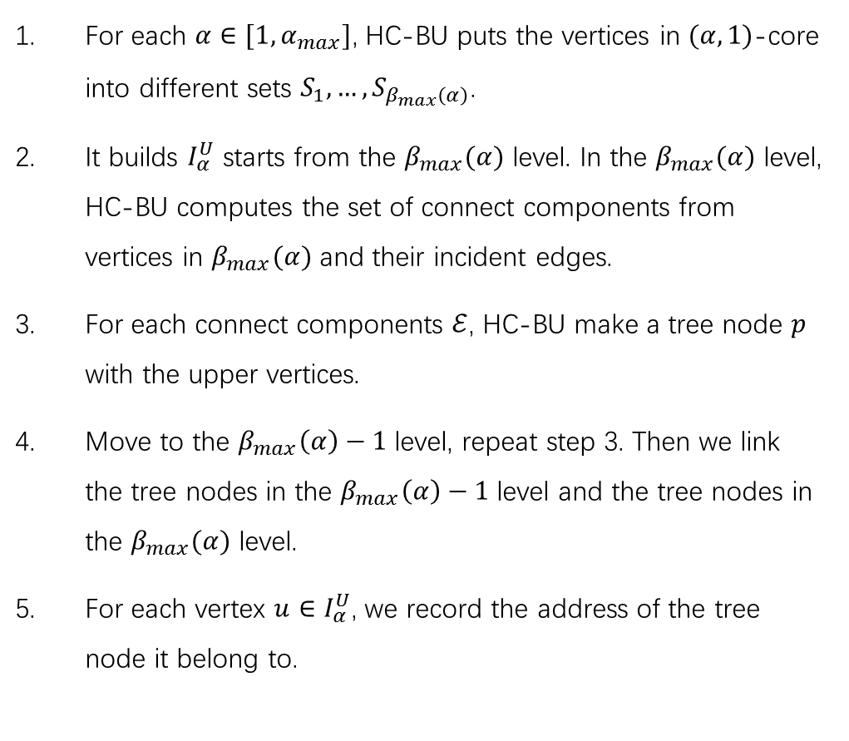
Bottom-up approach
For each $α∈[1, α_{max}]$, HC-BU puts the vertices in $(α,1)$-core into different sets $S_{1},…, S_{β_{max}\left(α\right)}$.
It builds $I_{α}^{U}$ starts from the $β_{max}(α)$ level. In the $β_{max}(α)$ level, HC-BU computes the set of connect components from vertices in $β_{max}(α)$ and their incident edges.
For each connect components $ℰ$, HC-BU make a tree node $p$ with the upper vertices.
Move to the $β_{max}\left(α\right)−1$ level, repeat step 3. Then we link the tree nodes in the $β_{max}\left(α\right)−1$ level and the tree nodes in the $β_{max}(α)$ level.
For each vertex ${u∈I}_{α}^{U}$, we record the address of the tree node it belong to.

Slide 20
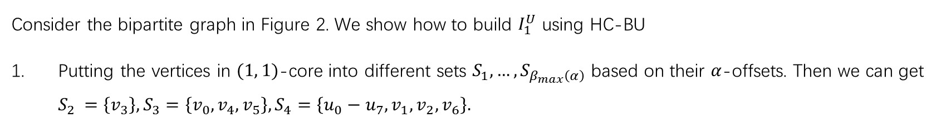
Bottom-up approach (example)
Consider the bipartite graph in Figure 2. We show how to build $I_{1}^{U}$ using HC-BU
Putting the vertices in $(1, 1)$-core into different sets $S_{1},…, S_{β_{max}\left(α\right)}$ based on their $α$-offsets. Then we can get $S_{2 }=\left\{v_{3}\right\}, S_{3}=\left\{v_{0},v_{4},v_{5}\right\}, S_{4}=\left\{u_{0}−u_{7}, v_{1},v_{2},v_{6}\right\}.$
u0
u1
u2
u3
u4
u5
u6
u7
v0
v1
v2
v3
v4
v5
v6
Fig. 2. A bipartite graph G

Slide 21


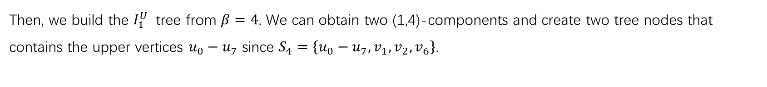



Bottom-up approach (example)
Then, we build the $I_{1}^{U}$ tree from $β=4$. We can obtain two (1,4)-components and create two tree nodes that contains the upper vertices $u_{0}−u_{7}$ since $S_{4}=\left\{u_{0}−u_{7}, v_{1},v_{2},v_{6}\right\}$.
$$I_{1}^{U}$$
u0
u1
u2
u3
u4
u5
u6
u7
root
$$1$$
（1-4)-core
$$2$$
$$3$$
v0
v1
v2
v3
v4
v5
v6
$$4$$
u0 u1 u2 u3
u4 u5 u6 u7
Fig. 2. A bipartite graph G

Slide 22
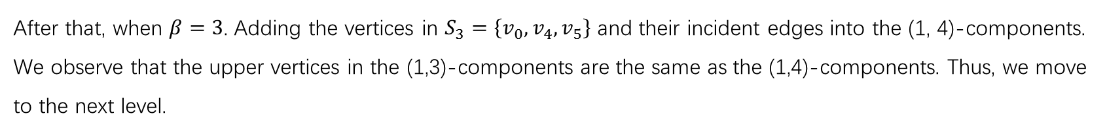
Bottom-up approach (example)
After that, when $β=3$. Adding the vertices in $S_{3}=\left\{v_{0},v_{4},v_{5}\right\}$ and their incident edges into the (1, 4)-components. We observe that the upper vertices in the (1,3)-components are the same as the (1,4)-components. Thus, we move to the next level.
$$I_{1}^{U}$$
u0
u1
u2
u3
u4
u5
u6
u7
root
$$1$$
（1-3)-core
$$2$$
$$3$$
v0
v1
v2
v3
v4
v5
v6
$$4$$
u0 u1 u2 u3
u4 u5 u6 u7
Fig. 2. A bipartite graph G

Slide 23
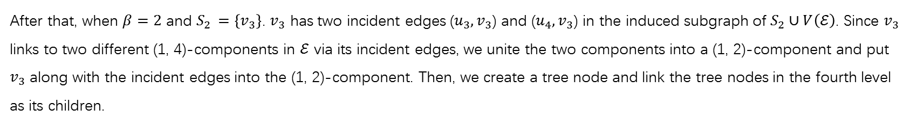
Bottom-up approach (example)
After that, when $β=2$ and $S_{2 }=\left\{v_{3}\right\}$. $v_{3}$ has two incident edges (${u_{3}, v}_{3}$) and (${u_{4}, v}_{3}$) in the induced subgraph of $S_{2}∪V\left(ℰ\right)$. Since $v_{3}$ links to two different (1, 4)-components in $ℰ$ via its incident edges, we unite the two components into a (1, 2)-component and put $v_{3}$ along with the incident edges into the (1, 2)-component. Then, we create a tree node and link the tree nodes in the fourth level as its children.
$$I_{1}^{U}$$
u0
u1
u2
u3
u4
u5
u6
u7
root
$$1$$
（1-2)-core
$$2$$
$$3$$
v0
v1
v2
v3
v4
v5
v6
$$4$$
u0 u1 u2 u3
u4 u5 u6 u7
Fig. 2. A bipartite graph G

Slide 24
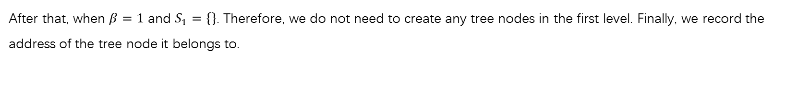
Bottom-up approach (example)
After that, when $β=1$ and $S_{1}=\{\}$. Therefore, we do not need to create any tree nodes in the first level. Finally, we record the address of the tree node it belongs to.
$$I_{1}^{U}$$
u0
u1
u2
u3
u4
u5
u6
u7
root
$$1$$
（1-1)-core
$$2$$
$$3$$
v0
v1
v2
v3
v4
v5
v6
$$4$$
u0 u1 u2 u3
u4 u5 u6 u7
Fig. 2. A bipartite graph G
$loc[$u$][α]$
$$α$$
1
..
..

Slide 25
Edge insertion
We design the HM-Ins algorithm to insert edges. The insertion process is as follows:
We first identify the affected trees on the bipartite hierarchy. Then, we identify the affected upper/lower vertices on each affected upper/lower tree.
We move down the vertices with increased offsets in the hierarchy.
We merge the tree nodes regarding the merged components.

Slide 26





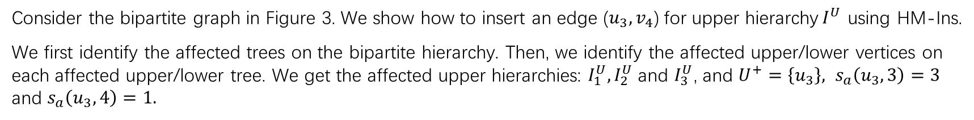


Edge insertion (example)
Consider the bipartite graph in Figure 3. We show how to insert an edge ($u_{3}, v_{4}$) for upper hierarchy$I^{U}$ using HM-Ins.
We first identify the affected trees on the bipartite hierarchy. Then, we identify the affected upper/lower vertices on each affected upper/lower tree. We get the affected upper hierarchies: $I_{1}^{U},I_{2}^{U}$ and $I_{3}^{U}$, and $U^{+}=\left\{u_{3}\right\}, s_{a}\left(u_{3},3\right)=3$ and $s_{a}\left(u_{3},4\right)=1.$
$$I_{1}^{U}$$
$$I_{2}^{U}$$
$$I_{3}^{U}$$
u0
u1
u2
u3
u4
u5
u6
u7
root
root
root
$$1$$
u3
$$2$$
u4
$$3$$
u5 u6 u7
u0 u1 u2
u5 u6 u7
$$4$$
u0 u1 u2 u3
u4 u5 u6 u7
u0 u1 u2 u3
v0
v1
v2
v3
v4
v5
v6
Fig. 3. A bipartite graph G

Slide 27







Edge insertion (example)
Then, when $α=1$, $lv\left(u_{3}\right)=4$ and $lv\left(v_{4}\right)=4$. And $v_{4}$ connected two components in the fourth level of $I_{1}^{U}$. Therefore, we need to merge these two components.
$$I_{1}^{U}$$
$$I_{2}^{U}$$
$$I_{3}^{U}$$
root
root
root
$$1$$
u3
$$2$$
u4
$$3$$
u5 u6 u7
u0 u1 u2
u5 u6 u7
u0 u1 u2 u3
u4 u5 u6 u7
u0 u1 u2 u3
$$4$$
u0 u1 u2 u3
u4 u5 u6 u7
v4

Slide 28


Edge insertion (example)
Then, when $α=2$, $lv\left(u_{3}\right)=4$ and $lv\left(v_{4}\right)=3$. $v_{4}$ connects two components, one is in the third level and another one is in the fourth level of $I_{2}^{U}$.
$$I_{1}^{U}$$
$$I_{2}^{U}$$
$$I_{3}^{U}$$
root
root
root
$$1$$
u3
$$2$$
u4
$$3$$
u5 u6 u7
u5 u6 u7
u0 u1 u2
u5 u6 u7
v4
$$4$$
u0 u1 u2 u3
u4 u5 u6 u7
u0 u1 u2 u3
u0 u1 u2 u3

Slide 29

Edge insertion (example)
Then, when $α=3$, $u_{3}$ will be moved from the first level to the third level since $U^{+}=\left\{u_{3}\right\}$ and $s_{a}\left(u_{3},3\right)=3$. $lv\left(u_{3}\right)=3$ and $lv\left(v_{4}\right)=3$. And $v_{4}$ connects two components in the third level of $I_{3}^{U}$. Therefore, HM-Ins merge these tree nodes in the third level of $I_{3}^{U}$.
$$I_{1}^{U}$$
$$I_{2}^{U}$$
$$I_{3}^{U}$$
root
root
root
$$1$$
u3
$$2$$
u4
u0 u1 u2 u3
u5 u6 u7
$$3$$
u5 u6 u7
u0 u1 u2
v4
$$4$$
u0 u1 u2 u3
u4 u5 u6 u7
u0 u1 u2 u3

Slide 30
Edge insertion (example)
Then, when $α=3$, $u_{3}$ will be moved from the first level to the third level since $U^{+}=\left\{u_{3}\right\}$ and $s_{a}\left(u_{3},3\right)=3$. $lv\left(u_{3}\right)=3$ and $lv\left(v_{4}\right)=3$. And $v_{4}$ connects two components in the third level of $I_{3}^{U}$. Therefore, HM-Ins merge these tree nodes in the third level of $I_{3}^{U}$.
$$I_{1}^{U}$$
$$I_{2}^{U}$$
$$I_{3}^{U}$$
root
root
root
$$1$$
$$2$$
u4
$$3$$
u5 u6 u7
u0 u1 u2 u3
u5 u6 u7
$$4$$
u0 u1 u2 u3
u4 u5 u6 u7
u0 u1 u2 u3

Slide 31


Edge insertion (example)
Then, when $α=4$, HM-Ins will create a new tree node in the first level of $I_{4}^{U}$ since $U^{+}=\left\{u_{3}\right\}$ and $s_{a}\left(u_{3},3\right)=3$. We do not need to merge the tree nodes in the $I_{4}^{U}$ since there is only one vertex.
$$I_{1}^{U}$$
$$I_{2}^{U}$$
$$I_{3}^{U}$$
$$I_{4}^{U}$$
root
root
root
root
$$1$$
u4
$$2$$
u4
$$3$$
u5 u6 u7
u0 u1 u2 u3
u5 u6 u7
$$4$$
u0 u1 u2 u3
u4 u5 u6 u7
u0 u1 u2 u3

Slide 32
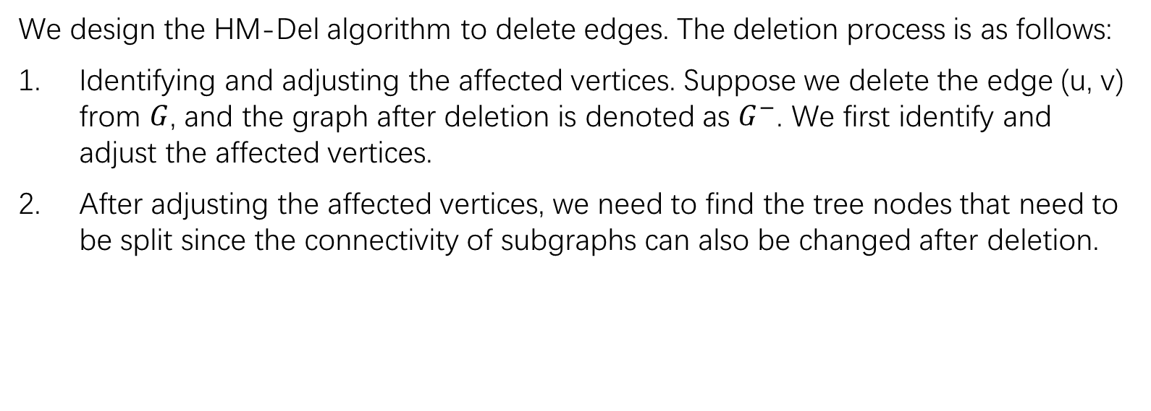
Edge deletion
We design the HM-Del algorithm to delete edges. The deletion process is as follows:
Identifying and adjusting the affected vertices. Suppose we delete the edge (u, v) from $G$, and the graph after deletion is denoted as $G^{−}$. We first identify and adjust the affected vertices.
After adjusting the affected vertices, we need to find the tree nodes that need to be split since the connectivity of subgraphs can also be changed after deletion.

Slide 33
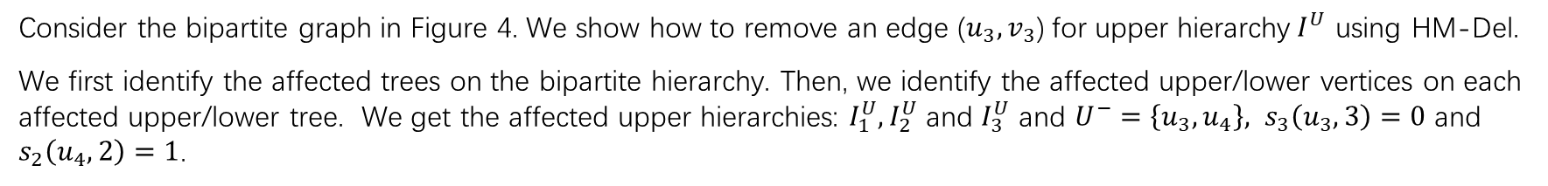
Edge deletion (example)
Consider the bipartite graph in Figure 4. We show how to remove an edge ($u_{3}, v_{3}$) for upper hierarchy$I^{U}$ using HM-Del.
We first identify the affected trees on the bipartite hierarchy. Then, we identify the affected upper/lower vertices on each affected upper/lower tree. We get the affected upper hierarchies: $I_{1}^{U},I_{2}^{U}$ and $I_{3}^{U}$ and $U^{−}=\left\{u_{3}, u_{4}\right\}, s_{3}\left(u_{3},3\right)=0$ and $s_{2}\left(u_{4},2\right)=1$.
$$I_{1}^{U}$$
$$I_{2}^{U}$$
$$I_{3}^{U}$$
u0
u1
u2
u3
u4
u5
u6
u7
root
root
root
$$1$$
u3
$$2$$
u4
$$3$$
u5 u6 u7
u0 u1 u2
u5 u6 u7
$$4$$
u0 u1 u2 u3
u4 u5 u6 u7
u0 u1 u2 u3
v0
v1
v2
v3
v4
v5
v6
Fig. 4. A bipartite graph G

Slide 34
Edge deletion (example)
Then, when $α=1$, $lv\left(u_{3}\right)=4$ and $lv\left(v_{3}\right)=2$. Thus, we split the tree node at the second level as $v_{3}$ does not connect $u_{3}$ anymore.
$$I_{1}^{U}$$
$$I_{2}^{U}$$
$$I_{3}^{U}$$
root
root
root
$$1$$
u3
$$2$$
u4
v3
$$3$$
X
u5 u6 u7
u0 u1 u2
u5 u6 u7
$$4$$
u0 u1 u2 u3
u4 u5 u6 u7
u0 u1 u2 u3

Slide 35
Edge deletion (example)
Then, when $α=2$, $lv\left(u_{3}\right)=4$ and $lv\left(v_{3}\right)=2$. We first move the vertex $u_{4}$ from the second level to the first level of $I_{2}^{U}$ as $s_{a}\left(u_{4},2\right)=1$. Then we split the tree node at the first level as $v_{3}$ does not connect $u_{3}$ anymore.
$$I_{1}^{U}$$
$$I_{2}^{U}$$
$$I_{3}^{U}$$
root
root
root
$$1$$
u3
$$2$$
v3
u4
$$3$$
X
u5 u6 u7
u0 u1 u2
u5 u6 u7
$$4$$
u0 u1 u2 u3
u4 u5 u6 u7
u0 u1 u2 u3

Slide 36
Edge deletion (example)
Then, when $α=2$, $lv\left(u_{3}\right)=4$ and $lv\left(v_{3}\right)=2$. We first move the vertex $u_{4}$ from the second level to the first level of $I_{2}^{U}$ as $s_{a}\left(u_{4},2\right)=1$. Then we split the tree node at the first level as $v_{3}$ does not connect $u_{3}$ anymore.
$$I_{1}^{U}$$
$$I_{2}^{U}$$
$$I_{3}^{U}$$
root
root
root
$$1$$
u4
u3
$$2$$
v3
$$3$$
X
u5 u6 u7
u0 u1 u2
u5 u6 u7
$$4$$
u0 u1 u2 u3
u4 u5 u6 u7
u0 u1 u2 u3

Slide 37
Edge deletion (example)
Then, when $α=2$, $lv\left(u_{3}\right)=4$ and $lv\left(v_{3}\right)=2$. We first move the vertex $u_{4}$ from the second level to the first level of $I_{2}^{U}$ as $s_{a}\left(u_{4},2\right)=1$. Then we split the tree node at the first level as $v_{3}$ does not connect $u_{3}$ anymore.
$$I_{1}^{U}$$
$$I_{2}^{U}$$
$$I_{3}^{U}$$
root
root
root
$$1$$
u4
u3
$$2$$
$$3$$
u5 u6 u7
u0 u1 u2
u5 u6 u7
$$4$$
u0 u1 u2 u3
u4 u5 u6 u7
u0 u1 u2 u3

Slide 38


Edge deletion (example)
When $α=3$, $lv\left(u_{3}\right)=0$ and $lv\left(v_{3}\right)=1$. We first remove the vertex $u_{3}$ from the first level of $I_{3}^{U}$ as $s_{a}\left(u_{3},3\right)=0$.
$$I_{1}^{U}$$
$$I_{2}^{U}$$
$$I_{3}^{U}$$
root
root
root
$$1$$
u4
u3
v3
X
$$2$$
$$3$$
u5 u6 u7
u0 u1 u2
u5 u6 u7
$$4$$
u0 u1 u2 u3
u4 u5 u6 u7
u0 u1 u2 u3

Slide 39
Edge deletion (example)
When $α=3$, $lv\left(u_{3}\right)=0$ and $lv\left(v_{3}\right)=1$. We first remove the vertex $u_{3}$ from the first level of $I_{3}^{U}$ as $s_{a}\left(u_{3},3\right)=0$.
$$I_{1}^{U}$$
$$I_{2}^{U}$$
$$I_{3}^{U}$$
root
root
root
$$1$$
u4
$$2$$
$$3$$
u5 u6 u7
u0 u1 u2
u5 u6 u7
$$4$$
u0 u1 u2 u3
u4 u5 u6 u7
u0 u1 u2 u3

Slide 40
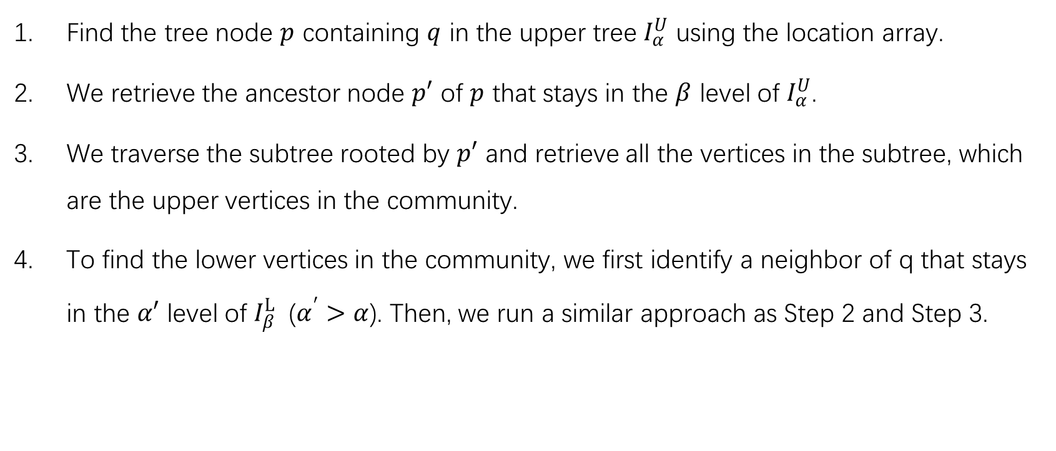
Community search
Find the tree node $p$ containing $q$ in the upper tree $I_{α}^{U}$ using the location array.
We retrieve the ancestor node $p′$ of $p$ that stays in the $β$ level of $I_{α}^{U}$.
We traverse the subtree rooted by $p′$ and retrieve all the vertices in the subtree, which are the upper vertices in the community.
To find the lower vertices in the community, we first identify a neighbor of q that stays in the $α′$ level of $I_{β}^{L}$ ($α^{′}>α$). Then, we run a similar approach as Step 2 and Step 3.

Slide 41
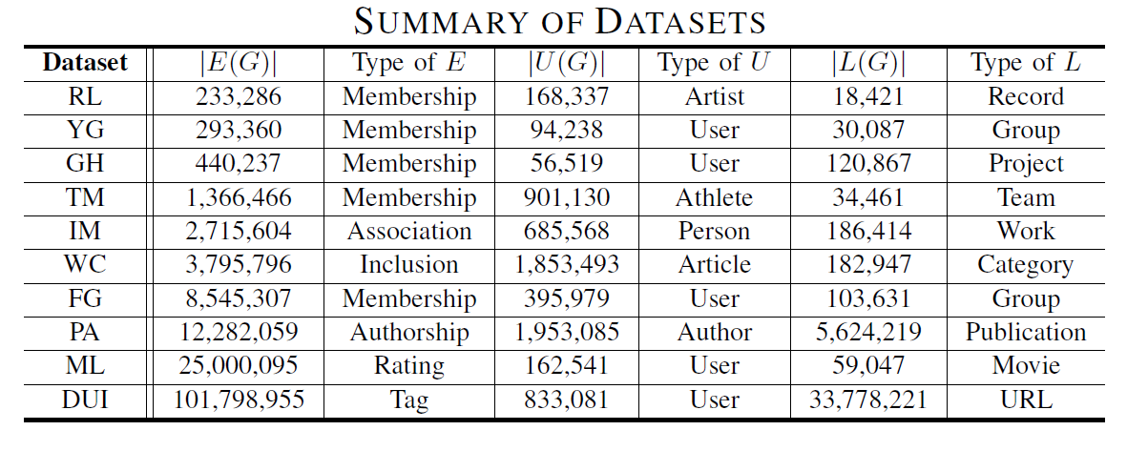
Experiments
Hierarchy construction
Hierarchy maintenance
Community search

Slide 42
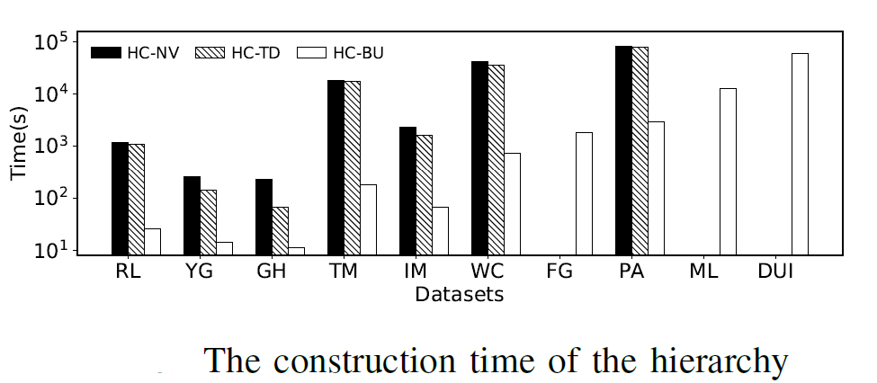
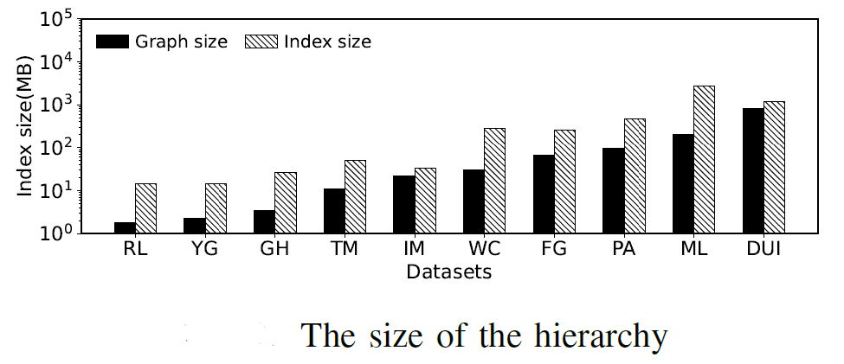
Bipartite hierarchy construction
HC-NV: the naïve algorithm that (1) search all the (𝛼, 𝛽)-cores directly from the input graph; and (2) computes the connected components for each (𝛼, 𝛽)-cores and makes tree nodes according to these connected components.

Slide 43
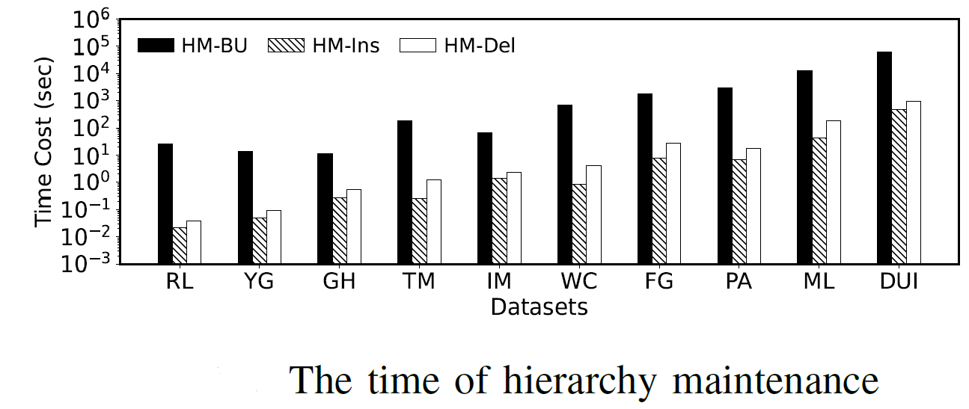
Bipartite hierarchy maintenance
We evaluate the performance on inserting/deleting a single edge

Slide 44
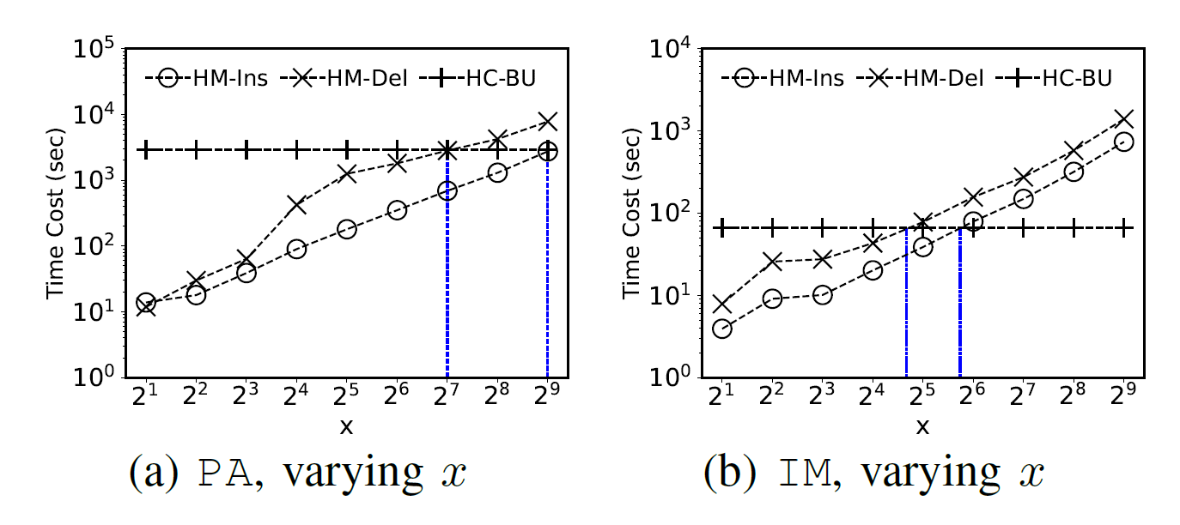
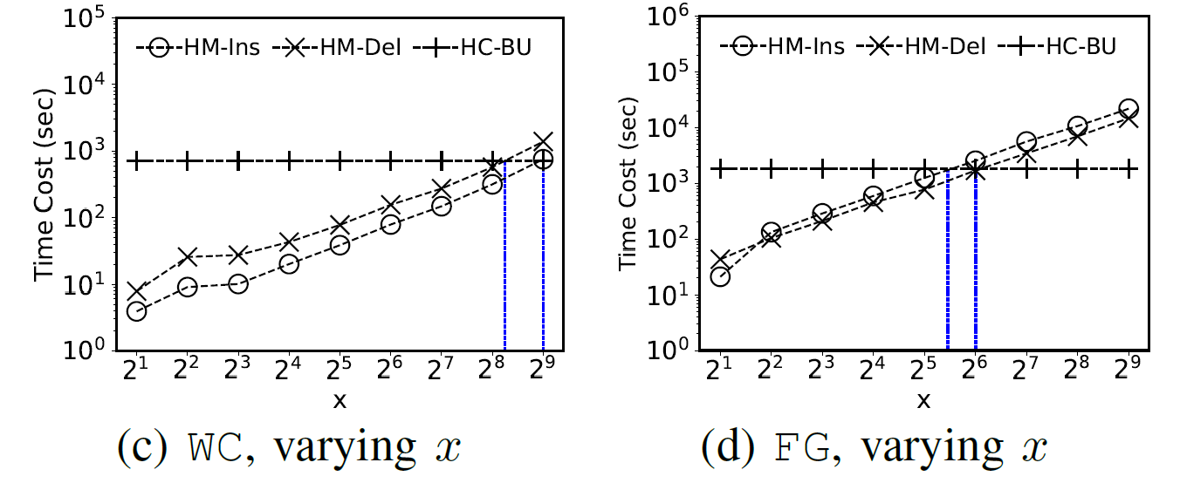

Bipartite hierarchy maintenance
We evaluate the performance on inserting/deleting $x$ edges
Notes:
we can observe that the running time of \newins and \newdel increases as the number of inserted/deleted edges increases. This is because \newins and \newdel need to touch a set of affected trees by each inserted/deleted edge and update the affected parts of these trees. On the other hand, the running time of \new is insensitive to the number of inserted/deleted edges since it builds all the trees no matter how many edges are inserted/deleted. Thus, if we insert/delete a large number of edges at the same time, \new can perform better than \newins and \newdel. For instance, on \texttt{PA} dataset, when there are about $2^7$ edges deleted, \new has almost the same running time as \newdel. After this tipping point, \new performs better than \newdel.

Slide 45
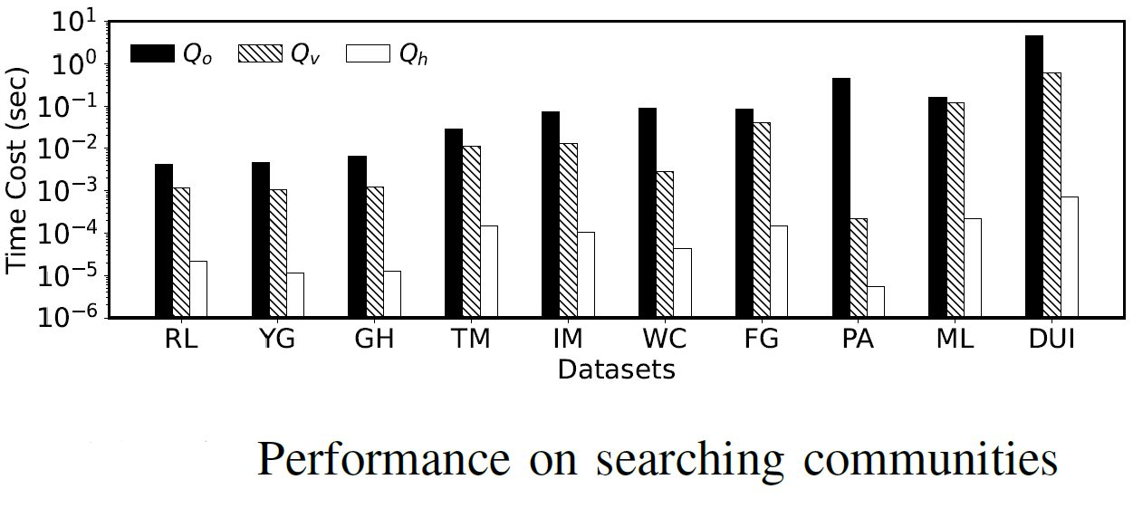
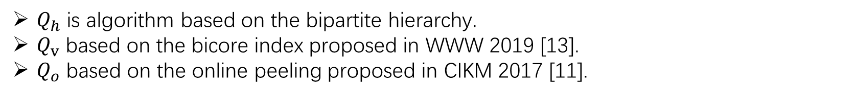
Community search
$Q_{h}$ is algorithm based on the bipartite hierarchy.
$Q_{v}$ based on the bicore index proposed in WWW 2019 [13].
$Q_{o}$ based on the online peeling proposed in CIKM 2017 [11].

Slide 46
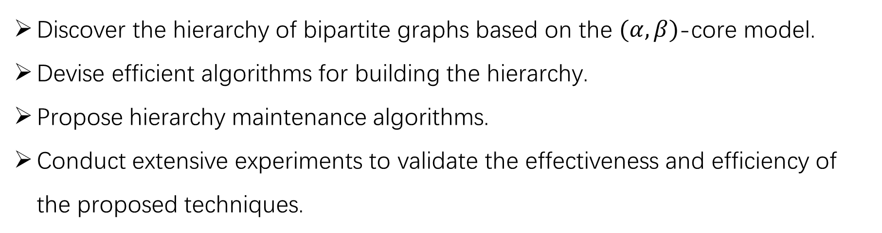
Conclusion
Discover the hierarchy of bipartite graphs based on the $(α, β)$-core model.
Devise efficient algorithms for building the hierarchy.
Propose hierarchy maintenance algorithms.
Conduct extensive experiments to validate the effectiveness and efficiency of the proposed techniques.

Slide 47
The End
Thanks for listening!

Slide 48
References
[1] Matula, D. W., & Beck, L. L. (1983). Smallest-last ordering and clustering and graph coloring algorithms. Journal of the ACM (JACM), 30(3), 417-427.
[2] Batagelj, V., & Zaversnik, M. (2003). An o (m) algorithm for cores decomposition of networks. CoRR. arXiv preprint cs.DS/0310049, 37.
[3] Huang, X., Cheng, H., Qin, L., Tian, W., & Yu, J. X. (2014, June). Querying k-truss community in large and dynamic graphs. In Proceedings of the 2014 ACM SIGMOD international conference on Management of data (pp. 1311-1322).
[4] Huang, X., Lakshmanan, L. V., Yu, J. X., & Cheng, H. (2015). Approximate closest community search in networks. arXiv preprint arXiv:1505.05956.
[5] Chang, L., Yu, J. X., Qin, L., Lin, X., Liu, C., & Liang, W. (2013, June). Efficiently computing k-edge connected components via graph decomposition. In Proceedings of the 2013 ACM SIGMOD International Conference on Management of Data (pp. 205-216).
[6] Zhou, R., Liu, C., Yu, J. X., Liang, W., Chen, B., & Li, J. (2012, March). Finding maximal k-edge-connected subgraphs from a large graph. In Proceedings of the 15th international conference on extending database technology (pp. 480-491).
[7] Wang, K., Lin, X., Qin, L., Zhang, W., & Zhang, Y. (2020, April). Efficient bitruss decomposition for large-scale bipartite graphs. In 2020 IEEE 36th International Conference on Data Engineering (ICDE) (pp. 661-672). IEEE.
[8] Zou, Z. (2016, April). Bitruss decomposition of bipartite graphs. In International conference on database systems for advanced applications (pp. 218-233). Springer, Cham.
[9] Ahmed, A., Batagelj, V., Fu, X., Hong, S. H., Merrick, D., & Mrvar, A. (2007, February). Visualisation and analysis of the Internet movie database. In 2007 6th International Asia-Pacific Symposium on Visualization (pp. 17-24). IEEE.
[10] Cerinšek, M., & Batagelj, V. (2015). Generalized two-mode cores. Social Networks, 42, 80-87.
[11] Ding, D., Li, H., Huang, Z., & Mamoulis, N. (2017, November). Efficient fault-tolerant group recommendation using alpha-beta-core. In Proceedings of the 2017 ACM on Conference on Information and Knowledge Management (pp. 2047-2050).
[12] Wang, K., Zhang, W., Lin, X., Zhang, Y., Qin, L., & Zhang, Y. (2021, April). Efficient and effective community search on large-scale bipartite graphs. In 2021 IEEE 37th International Conference on Data Engineering (ICDE) (pp. 85-96). IEEE.
[13] Liu, B., Yuan, L., Lin, X., Qin, L., Zhang, W., & Zhou, J. (2019, May). Efficient (α, β)-core computation: An index-based approach. In The World Wide Web Conference (pp. 1130-1141).

